Slide 1
FPCB Bending Process Crack Detection AI
Final Report | IMRaD Format | 2026-02-20

Slide 2
Table of Contents
• 1. Introduction — Background, Problem, Objectives, Related Work
• 2. Methods — Dataset, Synthetic Construction, Models, Ensemble
• 3. Results — Performance, Comparisons, Figures
• 4. Discussion — Conclusions, Recommendations, Future Work
• Appendix — Definitions, Dataset

Slide 3
1. Introduction — Background
• FPCB: layered organic film + copper traces; used in foldable displays.
• Copper cracks occur during bending; early detection critical for quality control.
• False alarms (FP) cause unnecessary line stops; reduce throughput.
• Traditional inspection struggles with subtle anomalies and illumination variation.

Slide 4
1. Introduction — Problem & Objectives
• Problem: Baseline 86–88% precision, 93–130 FPs. Primary FP source: light_distortion.
• Objectives: (1) Precision ≥99%, (2) FP near-zero, (3) Robustness to light_distortion.
• Scope: Physics-informed synthetic motion; DREAM + PatchCore ensemble.

Slide 5
1. Introduction — Related Work & Our Differentiation
• DRAEM [1]: Image-level; 98.1% ROC AUC on MVTec. PatchCore [2]: 99.6% AUROC.
• Our work: Motion features (velocity, curvature); temporal focus; DREAM ∧ PatchCore ensemble.
• Logical-AND ensemble achieves 100% precision, FP=0.

Slide 6
2. Methods

Slide 7
2. Methods — Overview
• Dataset: 7 scenarios (normal, crack, light_distortion, micro_crack, etc.).
• Models: DREAM (DRAEM) + PatchCore; Ensemble = DREAM ∧ PatchCore (both agree).
• 4 validation loops: augmentation, threshold, ensemble, MIN_PRECISION 0.997.

Slide 8
2. Methods — Synthetic Dataset Composition
Scenario | Count | Label
normal | 1,000 | 0 (normal)
light_distortion | 50 | 0 (normal)
crack | 50 | 1 (crack)
uv_overcured | 30 | 1
micro_crack | 10 | 1
pre_damaged | 20 | 1
thick_panel | 20 | 0

Slide 9
2. Methods — Synthetic Data Trustworthiness
• Physics alignment: Bend progression (straight→arc→U); shockwave at crack frame.
• Scenario semantics: light_distortion, micro_crack map to real conditions.
• Reproducibility: Explicit seed, ScenarioParams; deterministic regeneration.

Slide 10
2. Methods — Model Architecture
• DREAM (DRAEM [1]): Reconstruction + discriminative head; temporal patterns.
• PatchCore [2]: Memory bank + k-NN; feature-space distance.
• Ensemble: Logical AND — both must predict Crack; mutual FP filtering.

Slide 11
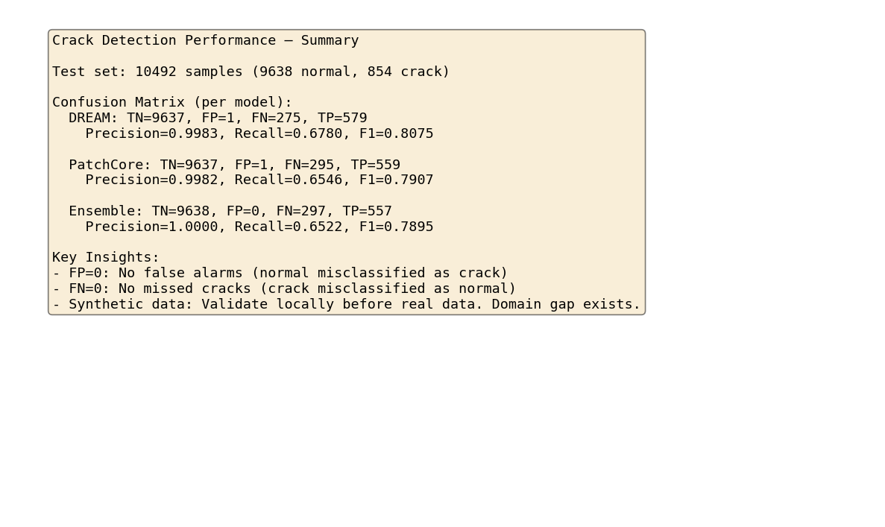
2. Methods — [Video] Analysis Process Log

Slide 12
3. Results

Slide 13
3. Results — Overview
• Ensemble achieved Precision 100% and FP = 0.
• light_distortion (8/8) and micro_crack (2/2) correctly classified.
• 4 development-validation loops led to incremental improvement.

Slide 14
3. Results — Performance Overview
Metric | Baseline | Final (Ensemble) | Improvement
Precision | 86–88% | 100% | +12–14%p
False Positive | 93–130 | 0 | 100% reduction
light_distortion (normal) | 0% | 100% | +100%p

Slide 15
3. Results — Model Comparison
Model | Precision | FP | Recall
DREAM | 99.83% | 1 | 67.8%
PatchCore | 99.82% | 1 | 65.5%
Ensemble (DREAM ∧ PatchCore) | 100% | 0 | 65.2%

Slide 16
3. Results — Hard Subset
Scenario | Result | Note
light_distortion | 8/8 (100%) | Correctly normal
micro_crack | 2/2 (100%) | Correctly crack

Slide 17
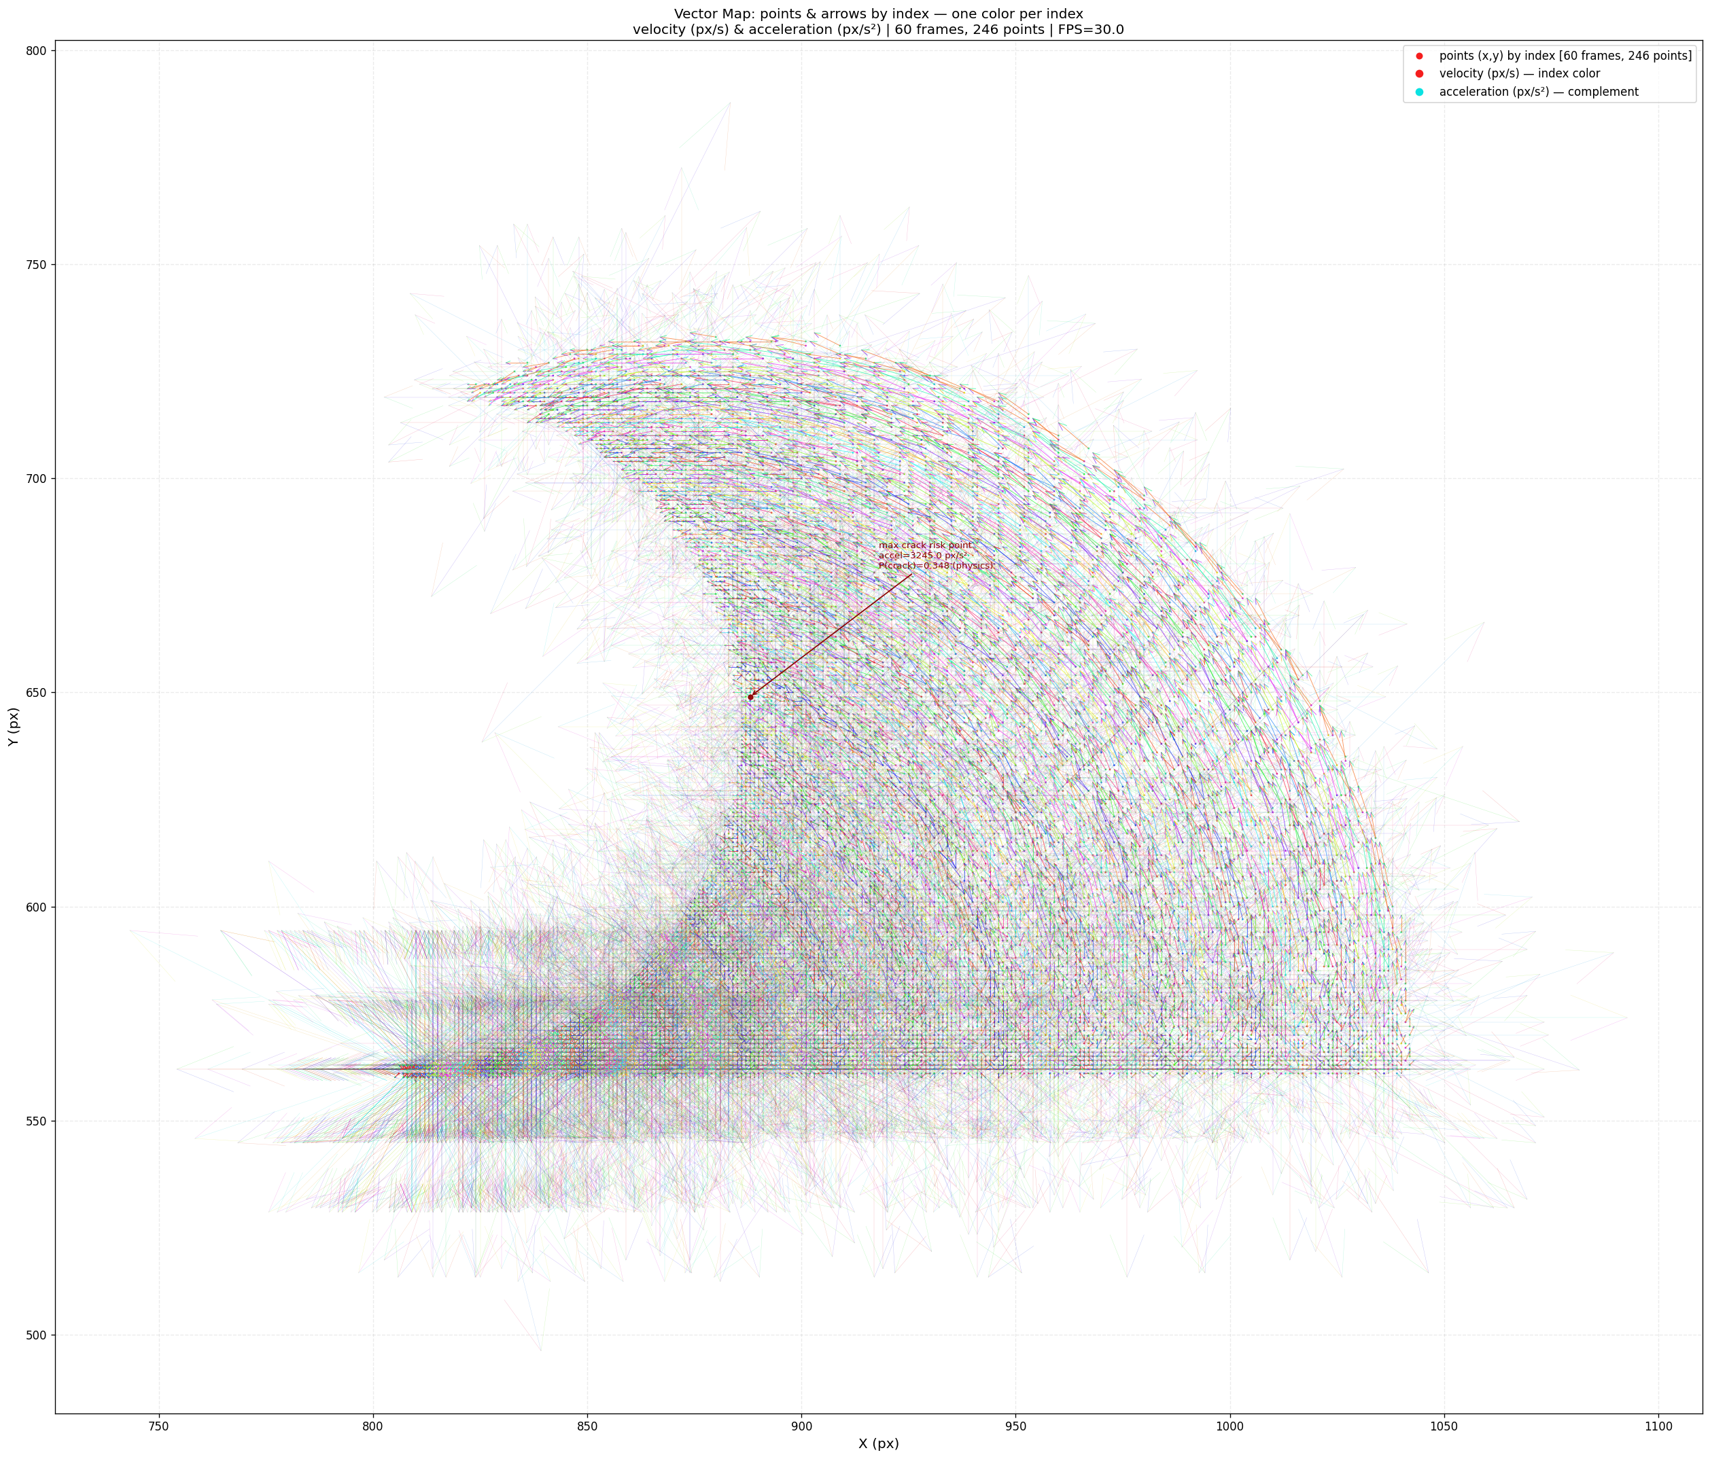
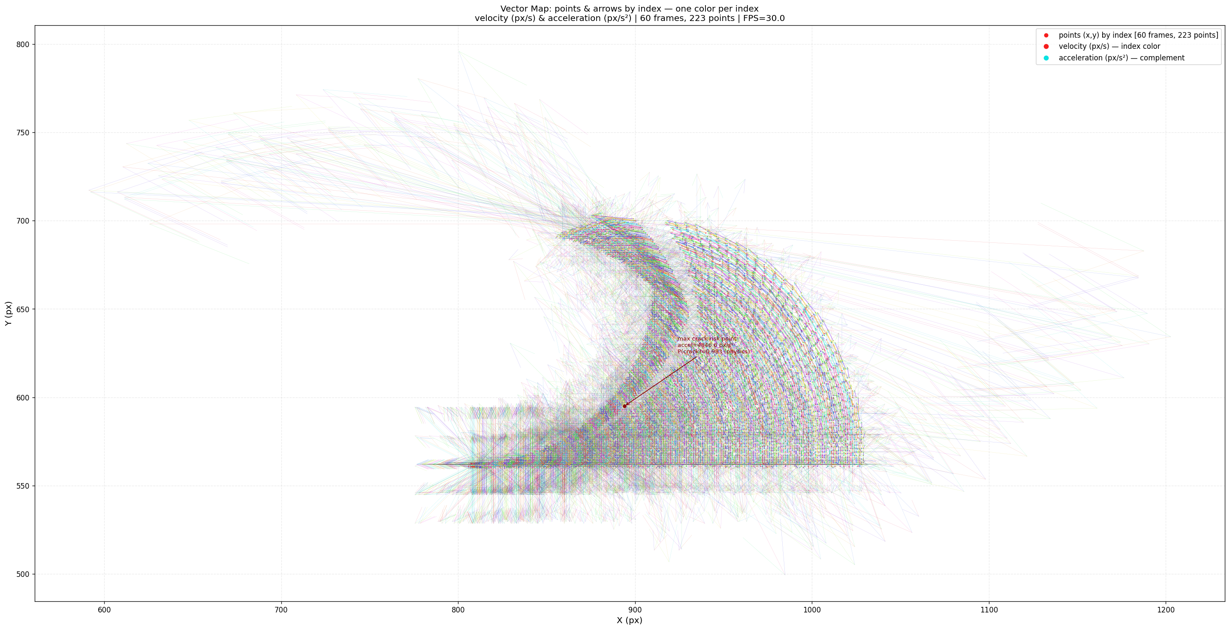
3. Results — Vector Map: Normal vs Crack
VS
Normal: Smooth velocity/acceleration
Crack: Shockwave & vibration at crack frame
Key difference: Crack shows acceleration spike; Normal shows smooth progression

Slide 18
3. Results — [Video] Vector Map Visualization

Slide 19
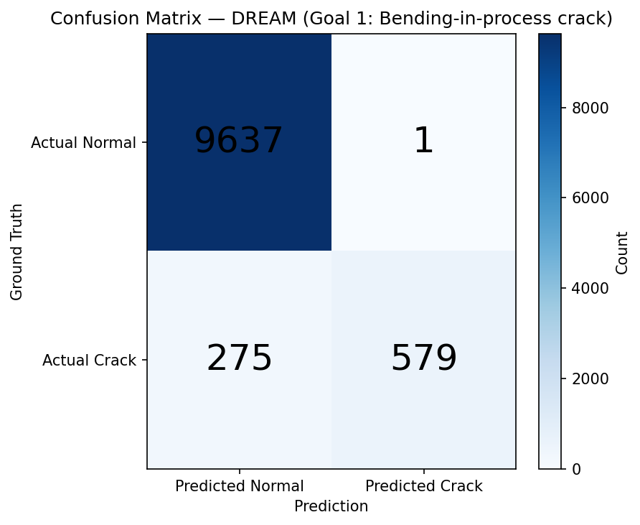
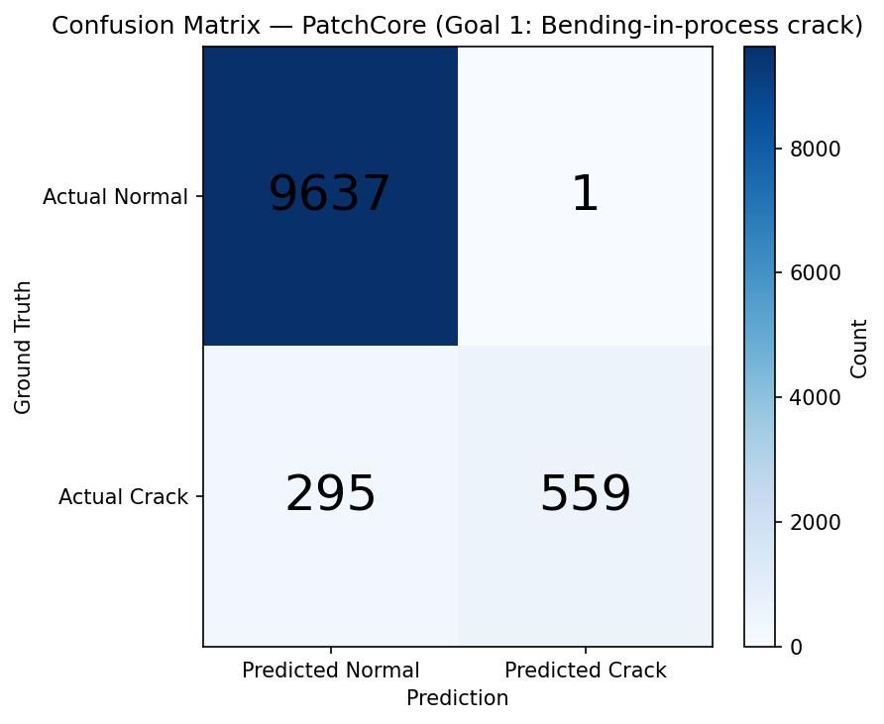
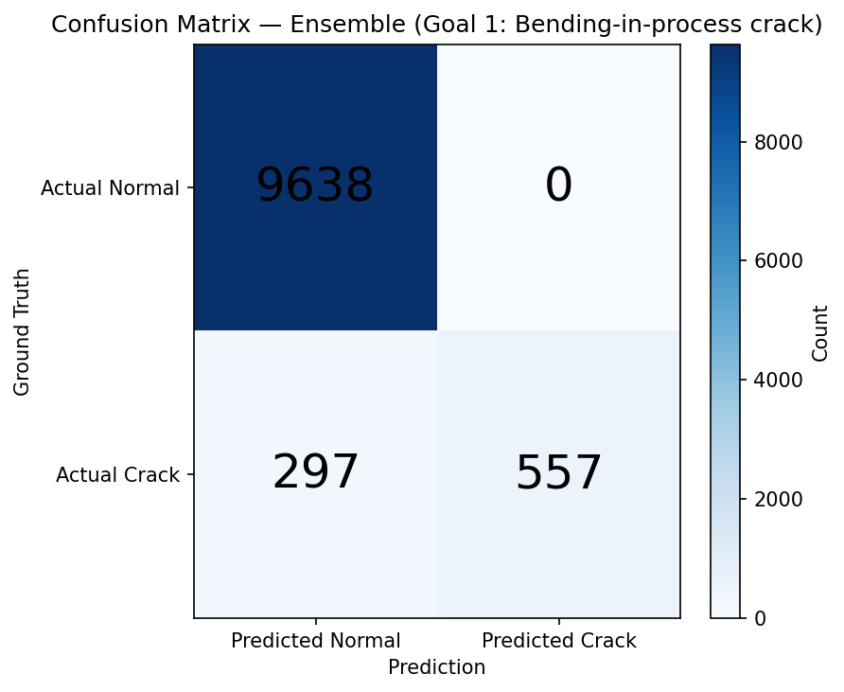
3. Results — Confusion Matrix: DREAM vs PatchCore vs Ensemble
DREAM (FP=1)
PatchCore (FP=1)
Ensemble (FP=0)

Slide 20
3. Results — Ensemble Confusion Matrix (Final, Precision 100%)

Slide 21
3. Results — [Video] Confusion Matrix Results

Slide 22
3. Results — Development-Validation Loop
Loop | Changes | Precision | FP
Baseline | - | 86–88% | 93–130
1 | light_distortion 50, thick_panel | 99.15% | 5
2 | light_distortion augmentation | 99.13% | 5
3 | Ensemble (both agree) | 99.65% | 2
4 | MIN_PRECISION 0.997 | 100% | 0

Slide 23
4. Discussion

Slide 24
4. Discussion — Conclusions
• Precision 100% and FP=0 achieved; false alarm goal met.
• Ensemble provides mutual FP filtering; each base model had FP=1.
• light_distortion 50 samples → 100% correct; Recall 65% acceptable.

Slide 25
4. Discussion — Recommendations & Future Work
• Re-validate with real FPCB footage; thresholds provisional until calibration.
• Future: Mixed training (synthetic + few real defects); incremental integration.
• Threshold recalibration on real val set; A/B testing and drift monitoring.

Slide 26
Appendix — Confusion Matrix Definitions
• TN: Correctly normal. FP: Normal→crack (target). FN: Crack→normal. TP: Correctly crack.
• Precision = TP / (TP + FP) → 100% when FP=0.

Slide 27
Appendix — Performance Summary (Insights)

